Slide 1
Stress detector
- Siddhi Sonawane

Slide 2

INTRODUCTION
Stress is a growing concern that affects both mental and physical health. The Human Stress Detection project aims to predict stress levels by analyzing physiological data such as heart rate, respiratory rate, and body temperature.
By detecting stress early, this tool can help individuals take steps to manage it more effectively, improving their overall health and well-being.

Slide 3
Project overview
Objective: Develop a web-based platform to assess and detect stress levels in individuals.
Data Input: The system collects data based on 9 key parameters that influence stress, such as heart rate, mood, sleep patterns, etc.
Prediction Mechanism: Using the input data, the platform predicts whether the user is stressed or not through an algorithm.
User-Friendly: Simple interface with easy navigation for logging in, entering data, and receiving stress predictions.
Impact: Helps individuals recognize stress early, promoting better mental

Slide 4
Parameters to detect stress
Snoring Rate
Respiratory Rate
Body Temperature
Limb Movement
Blood Oxygen
Eye Movement
Heart Rate
Sleep Hours
Stress Level

Slide 5
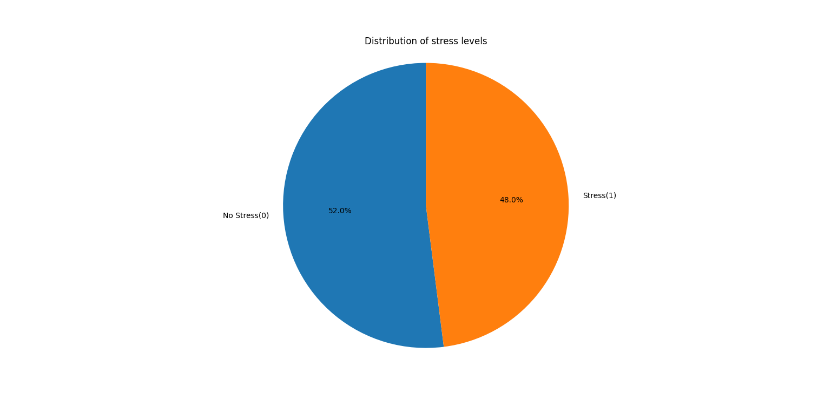
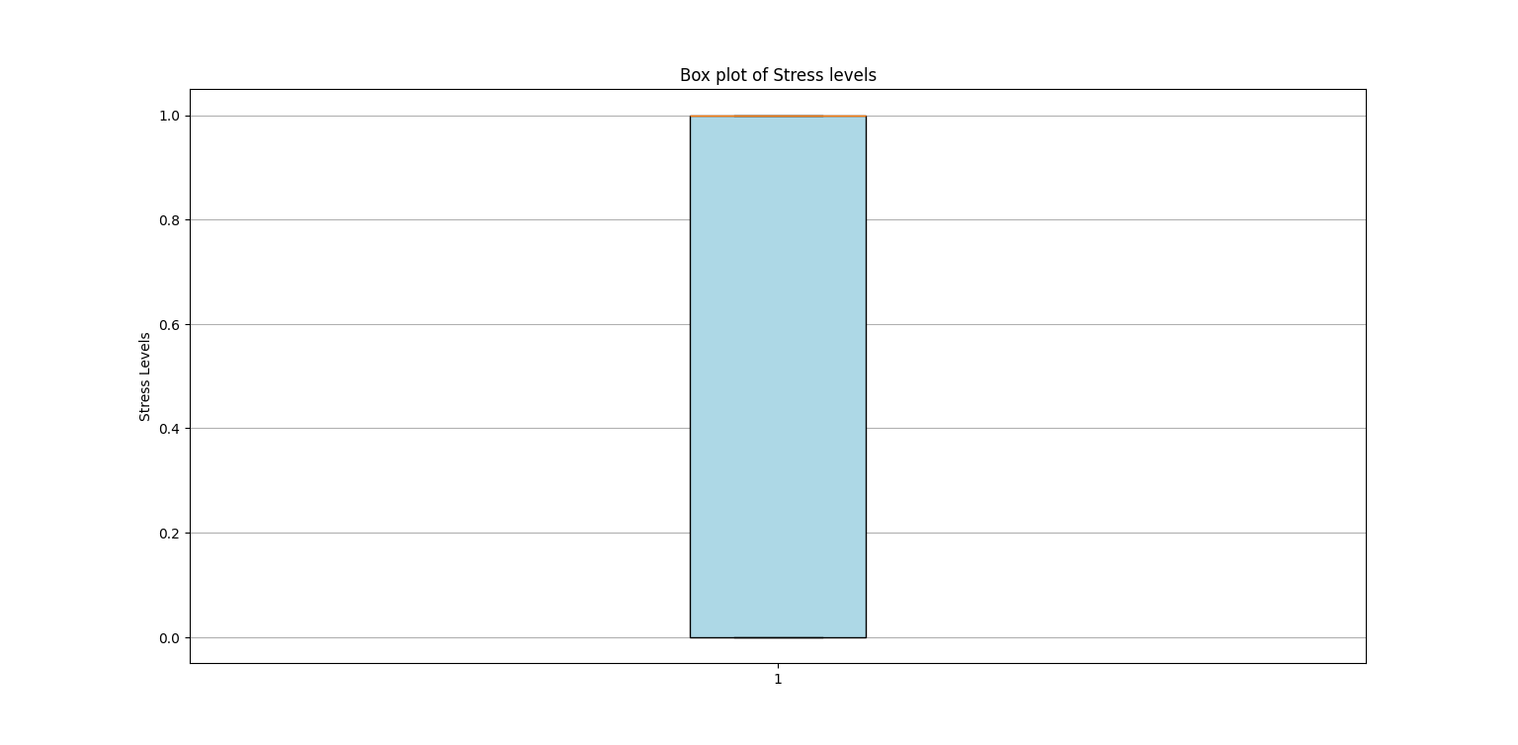
Data visualization

Slide 6
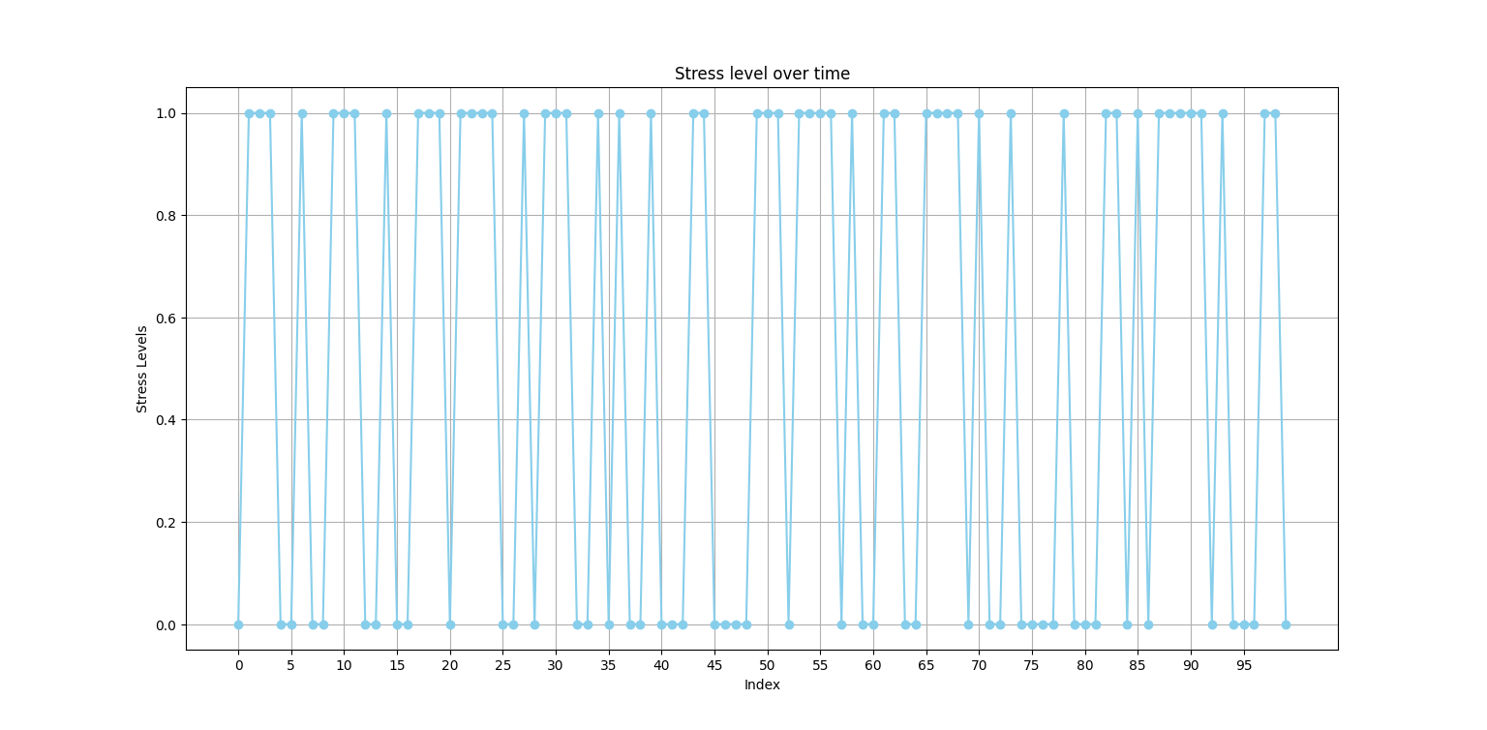
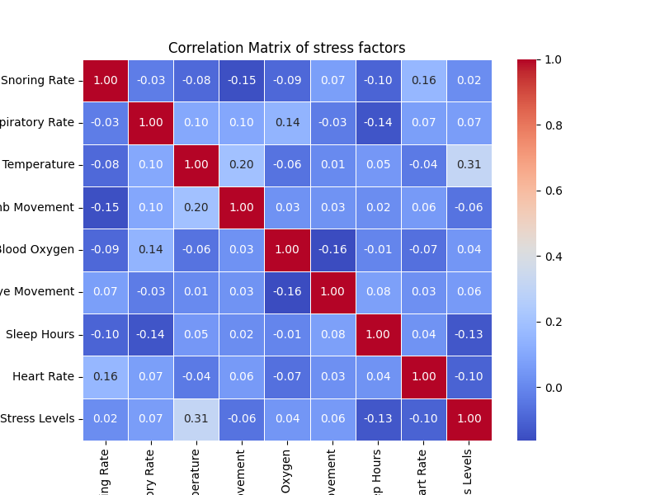

Slide 7
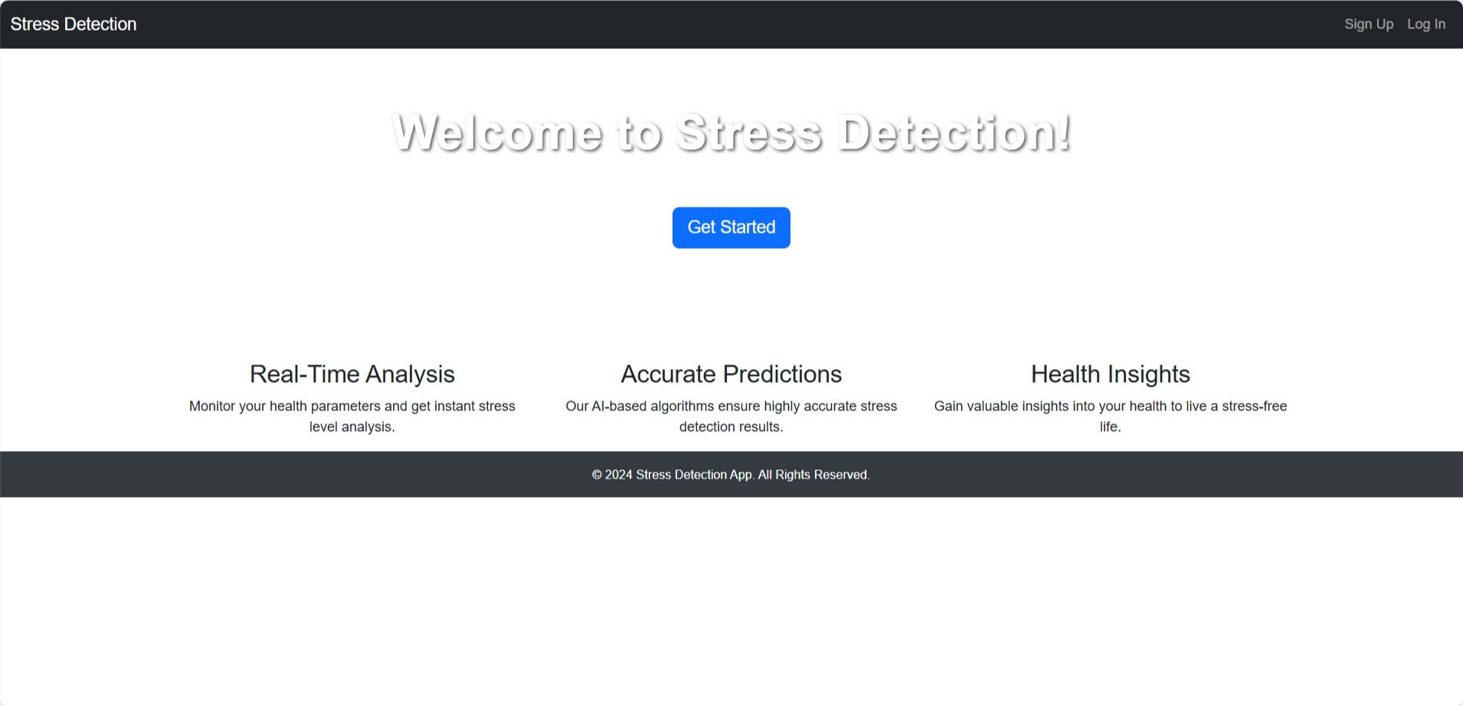
Website
HOME PAGE

Slide 8
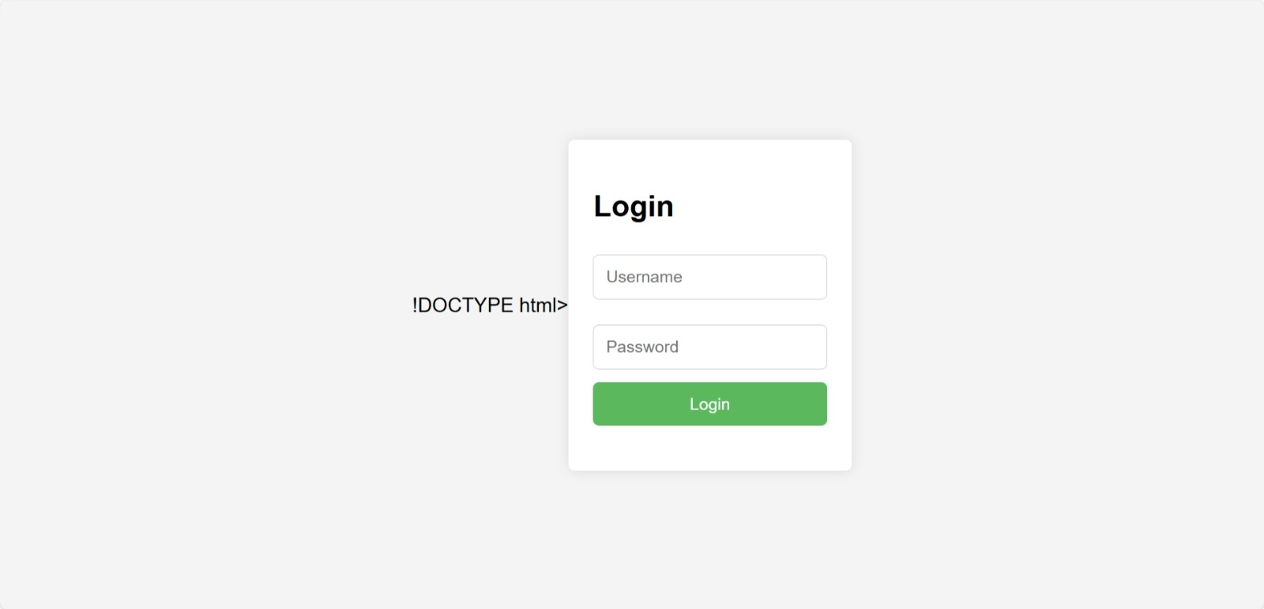
Login Page

Slide 9
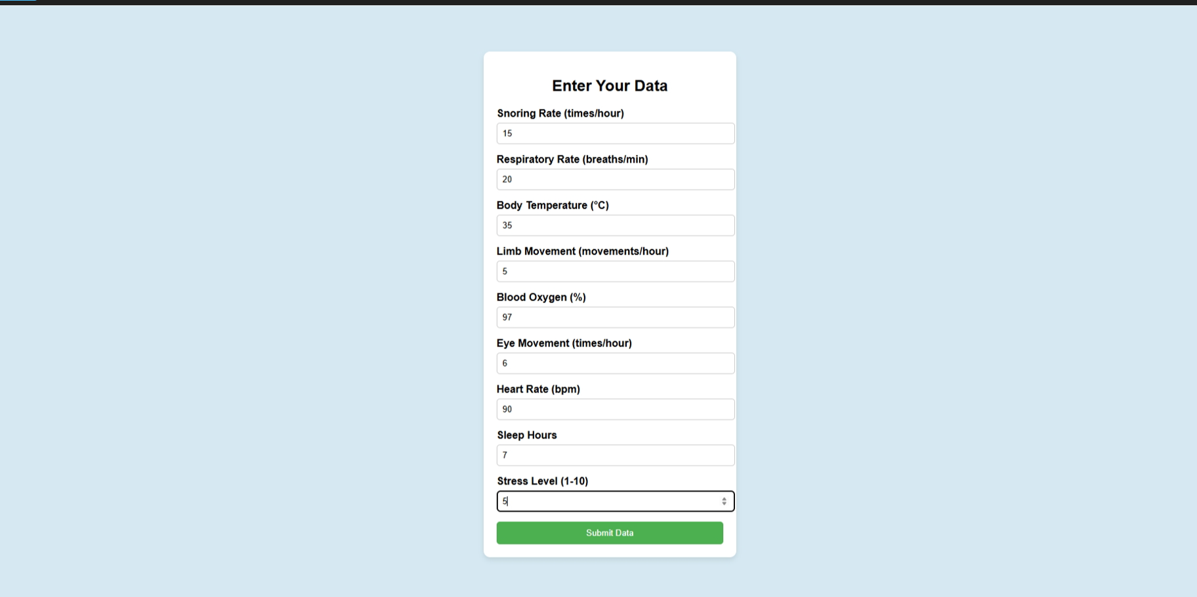
Data collection page

Slide 10
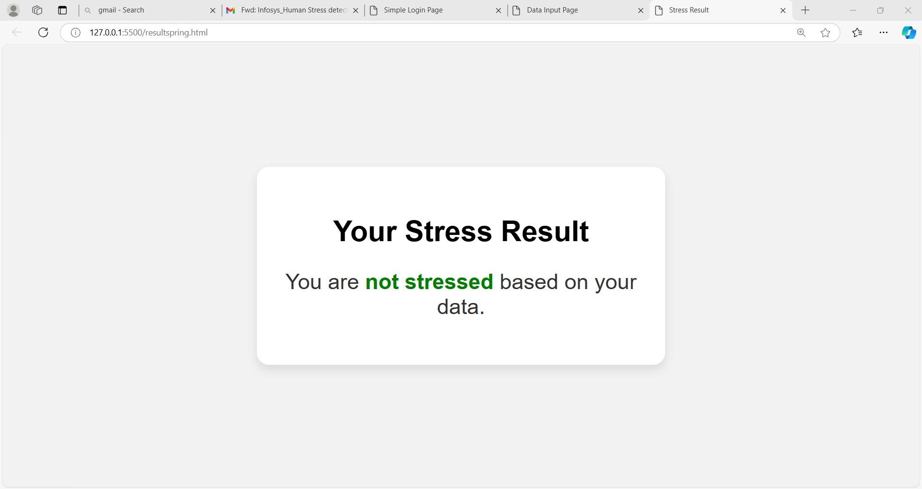
Result page

Slide 11

conclusion
The Human Stress Detection system provides a simple web-based platform for users to assess their stress levels by analyzing key factors like heart rate and mood. With an easy-to-use interface, users can quickly input data and receive immediate feedback on whether they are stressed. This helps promote early stress detection and encourages timely action to manage it.
The platform is accessible and scalable, with potential for future improvements like personalized recommendations and machine learning integration. Overall, it offers a practical solution for stress awareness, helping individuals better manage their mental health.

Slide 12


Slide 13
Thank you !

